Slide 1


Preston Moore
July 28, 2023

Slide 2

Outline
Executive Summary
Introduction
Methodology
Results
Dashboard
Discussion
Findings & Implications
Conclusion
Appendix
Visualizations
Charts
Github Repository Links: https://github.com/PrestonMoore3/IBM-Data-Science-Capstone.git
PrestonMoore3/IBM-Data-Science-Capstone: Completion of Tasks to Predict SpaceX Falcon9 Launch and Landing (github.com)

Slide 3
Executive Summary
Problem
Will the First Stage of the Space X Falcon 9 Successfully Launch and Land?
Potentially Save 103 million dollars or more.
Solution:
83% Chance of Success
I predicted the Space X Falcon 9 First Stage will successfully launch and land with a high level of certainty.
94% Precision of the Chance of Success Result
Provides information to see if alternative bids from other companies should be made.
Provide a predicted cost of a launch

Slide 4
Executive Summary
The outlook: bright!
Bottom Line:
Because we have a high level of certainty that the Stage One Space X Falcon 9 Rocket will launch and land successfully, we can use this information to provide competitive bids for which Space X will have significantly lower costs.

Slide 5
Introduction
Variables:
Booster Version​
Payload Mass ​
Orbit​
Launch Site​
Outcome​
Flights​
Grid Fins ​
Reused​
Legs​
Landing Pad​
Block​
Reused Count​
Serial​
Longitude​
Latitude
Project Background and Context​
Space X Falcon 9 Rocket Launches Failures and Successes​
Looking at success rate based on a large variety of variables.
Project Goal
The main goal was to find successful launches and landings versus unsuccessful launches/landings for each launch site.
The specific variables and parameters that led to successful landings were used to tune the Predictive Models.

Slide 6
In order to collect the data, extract relevant information, then obtain valuable insights, the following methods were utilized:​​
Data Collection with APIs​​
Data Wrangling​​
Exploratory Data Analysis with Pandas​​
Data Visualization​​
Folium Maps​​
Machine Learning Predictive Analysis​​
Predictive Modeling​​
SQL Database Queries​​
The Confusion Matrix​​
Summary of Findings:​
With 4 Machine Learning Algorithms utilized for Predictive Modeling, the prediction of landing certainty for the Space X Falcon 9 First Stage was 83%,with a precision of 94% that this prediction was correct and that the first stage has a reasonably high certainty of landing with the tuned hyperparameters.​

Slide 7

Section 1

Slide 8
Methodology
Executive Summary
Data collection methodology:
HTTP Requests were made to the SpaceX API.
Extracted specific data from the SpaceX API to append to a list for each specific variable.
Performed data wrangling
Created a Pandas DataFrame, then cleaned data that was missing or irrelevant .
Performed Exploratory Data Analysis (EDA) using visualization and SQL
Performed interactive visual analytics using Folium and Plotly Dash
Performed predictive analysis using classification models
Built, tuned, and produced Machine Learning Predictive Classification Models.

Slide 9
Data Collection
Data Sets were collected with an HTTP Request to the SpaceX API.
Functions were defined to gather data into lists that would be used to create the columns of a pandas DataFrame.
The requests.get function was used to collect the data from SpaceX.
The response content was in the form of a JSON file, meaning that it needed to be converted to a pandas DataFrame with .json_normalize()
The data from each request was prepared to be stored in the list to be used to create the DataFrame.
After all data was ready, the user-defined functions were called to store the data in the lists.
The columns were put into a dictionary called "launch_dict" and then was recreated into a pandas DataFrame called "data"

Slide 10

Data Collection
Rockets
Falcon 9
Falcon 1
Rockets Filtered
Falcon 9 only
Because Falcon 9 launches were the only desired pieces of data, the DataFrame filtered for Falcon 9 launches.
The collected data at this point included the variables that had effect only on Falcon 9 launches.

Slide 11
Data Collection – SpaceX API
Requested Rocket Launch Data from URL
Requested and Parsed Information with JSON Static Response Object Request
Decoded response object as JSON file.
Got subset of Dataframe with features we wanted.
Cleaned 'cores' and 'payload' columns
Got datetime information and restricted the date of the launches.
Prepared all information from API calls to be stored in lists.

Slide 12
Data Collection – Web Scraping
Called Rocket function.
Called Payload function.
Called launchpad function.
Called core function.
Created dictionary of lists created with the API calls.
Created Pandas Dataframe.

Slide 13
Data Collection GitHub URL
https://github.com/PrestonMoore3/IBM-Data-Science-Capstone/blob/637f30df5329d691297f511df4d4ffaa46123b7f/Data%20Collection%20with%20APIs.ipynb
Jupyter Notebook Rendered URL
Jupyter Notebook Viewer (nbviewer.org)

Slide 14
Data Wrangling
Imported required libraries: pandas and NumPy
In order to get started wrangling data, the data was analyzed to check for percentages of missing values, which was quite high for the "LandingPad" column.
Data Types were checked with df.dtypes
The number of launches per site, per Orbit Type, and per landing outcome were all calculated using the value_counts() method.
Looped through the data to create a list of unique key : value pairs. This helped show where the types of missions and their successes or failures could be found
Created an outcomes list for where the stage did not land successfully.

Slide 15
Data Wrangling - Insight
A Landing Class column was added by creation from the Outcome column.
The success rate overall was checked by using the .mean() method.
The ratio of Successful landings to failed landings was 0.6666 repeating, meaning a higher rate of success than failure.

Slide 16
Data Wrangling Flow Chart
Imported required libraries: pandas and NumPy
In order to get started wrangling data, the data was analyzed to check for percentages of missing values, which was quite high for the "LandingPad" column.
Data Types were checked with df.dtypes
The number of launches per site, per Orbit Type, and per landing outcome were all calculated using the value_counts() method.
Looped through the data to create a list of unique key : value pairs. This helped show where the types of missions and their successes or failures could be found
Created an outcomes list for where the stage did not land successfully.
The success rate overall was checked by using the .mean() me
A Landing Class column was added by creation from the Outcome column.

Slide 17
Data Wrangling GitHub URL
https://github.com/PrestonMoore3/IBM-Data-Science-Capstone/blob/637f30df5329d691297f511df4d4ffaa46123b7f/Data%20Wrangling.ipynb
Jupyter Notebook Rendered URL
Please download the file to view locally as the notebook cannot be rendered.

Slide 18
EDA with Data Visualization Methodology
Categorical Plots
These show the categories of class, representing whether or not a launch landing was successful or not clearly marked by the hue.
The best reason is to see how two variables will correlate together to produce the Success or Failure.
Categorical Plots easily visualize multiple pieces of specific data in relation to each axes.
Bar Charts
Made the comparison between multiple variables and the Success Rate Easily Visualized.
Line Chart
The Line Chart showed the yearly trend of Success Rate, because these changed from year to year making it easy to compare how Success Rate Changed over the years.

Slide 19
Summary of SQL Queries
Found the names of the Unique Launch Sites
Displayed Launch Sites with 'CCA' beginning the name.
Selected the Sum of the Payload Mass (kg) from boosters launched by NASA
Displayed the average payload mass carried by the booster version by averaging the Payload Mass (kg)
Found the first successful landing date on a ground pad.
Listed the names of the boosters by selecting the distinct booster with a Successful Landing using drone ships with a Payload Mass (kg) between 4000 and 6000.
Counted the total of successful and failed outcomes respectively.
Selected the Booser Versions that could carry the maximum Payload Mass (kg).
Displayed the failed landings for drone ships, their booster versions, and the corresponding launch sites in 2015.
Ranked the number of landing outcomes between the date 2010-06-04 and 2017-03-20, in descending order to show the specific ordered number of landings.
EDA with SQL Methodology

Slide 20
Folium Interactive Map of Launch Sites Methodology
Map Objects Utilized on the Folium Map:
Map with initial centered location to be the NASA Johnson Space Center in Houston, TX.
Circle – showed each launch site area.
Marker – showed the location of each launch site.
Marker Cluster – helped to simplify the map with multiple sites in one small area, when zoomed out.
Popup – provided information about the launch site.
MousePosition – provided latitude and longitude coordinates to help add additional map markings.
PolyLine - delineated the distances from a launch site to particular map features.

Slide 21
Plotly Dash Dashboard Methodology
Pie Chart – shows the percentage of distribution of success rates for all sites and specific site success ratios.
Scatter Chart - provides clarity as to where clusters of successful launches were to dive deeper into further understanding.
Dropdown – provided easily responsive feedback to explore different launch sites, payloads, and success rates with booster versions.
Slider – provided flexibility with interactive range to discover the best range for payload mass (kg)
All Components - top layer of where to begin further searching.
Individual Launch Site - provided the failure/success rate for each individual launch site.

Slide 22
Data Standardization using SciKit Learn Preprocessing
Train-Test-Split to create a Training Set and Testing Set of Data.
Tuned hyperparameters to find the best for the machine learning algorithms.
Machine Learning Algorithms Utilized:
K-Nearest Neighbors (KNN)
Decision Tree Classifier
Support Vector Machine
Logistic Regression
Created model using the training and testing data, then scored the Predictive Model of each algorithm against the actual dataset to determine accuracy of trained model.
Scoring:
F1 Score for Precision of the Results and the Accuracy of the model
Visualizations: Bar Chart, Confusion Matrix
Confusion Matrix:
Displayed the effectiveness of the best performing model to predict a landing outcome.
Predictive Analysis (Classification) Methodology & Flow Chart

Slide 23
Exploratory data analysis results
Interactive analytics demo in screenshots
Predictive analysis results
Interactive Folium Maps
Conclusions
Results Overview

Slide 24

Section 2

Slide 25
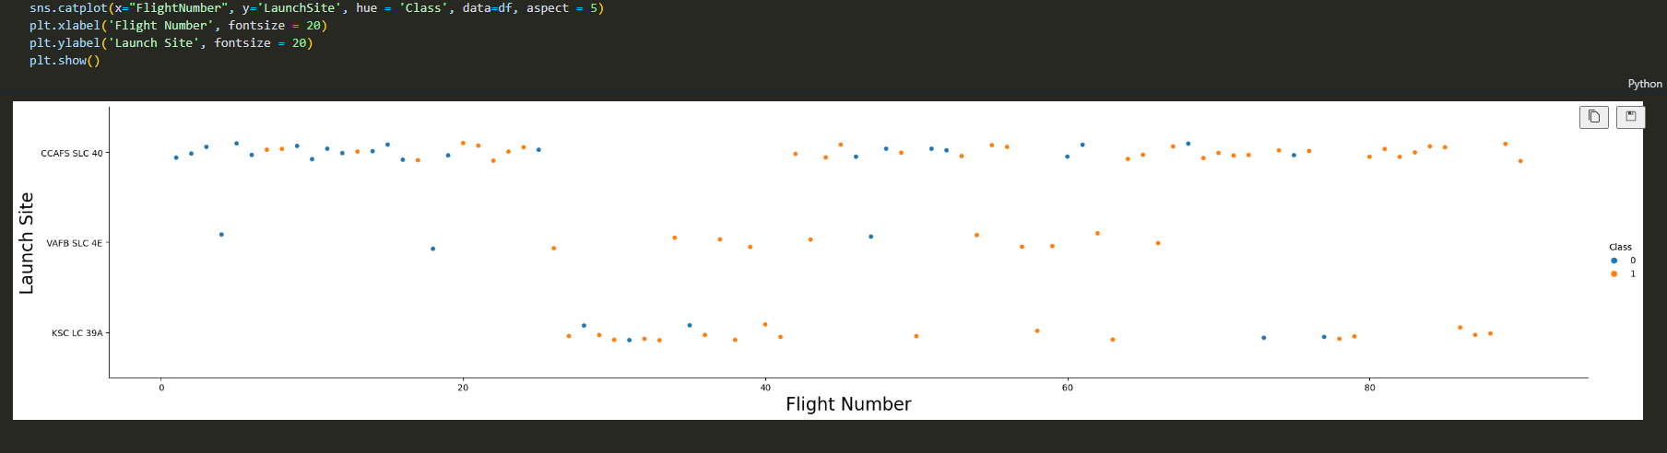
Looking at each flight number, for each Launch Site, we can see the classification of successes or failures based on flight number.
The insights:
For All Sites, there were many more successes as flight numbers increased
CCAFS SLC-40 Had a larger number of launches, especially with the higher Flight Numbers and the Lower Flight Numbers. This means that the site was revisited after trying flights at the other launch sites.
Once the VAFB and KSC sites were utilized with high success, we see an increase in successes with CCAFS.
KSC LC-39A had a high level of success in all flight numbers overall.
Flight Number vs. Launch Site

Slide 26
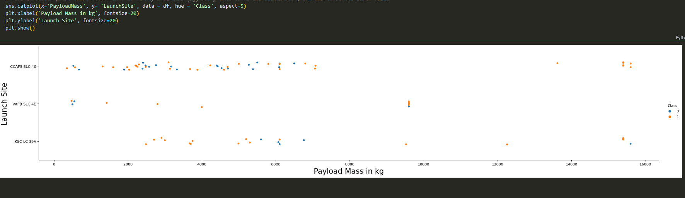
Displayed are the different Payload Mass in kg for each Launch Site, with classification of each launch Payload Mass per site as a success or failure.
Payload Mass in kg between 2,000 and 6,000 at KSC LC-39A and VAFB SLC-4E provided a high level of success rates.
Not many launches were completed with 8,000 to 15,000 kg Payload Mass.
CCAFS SLC-40 had a 100% success rate in the 13,500 to 16,000 kg Payload Mass.
CCAFS SLC-40 had mixed success with Payload Mass below 8,000 kg.
Payload vs. Launch Site

Slide 27
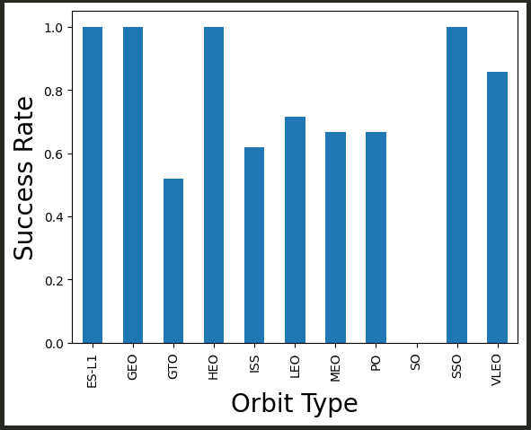
Success Rate vs. Orbit Type
The success rate by orbit type is compared between each type of Orbit.
Insights:
ES-L1, GEO, HEO, and SSO had the highest success Rate of 100%
One of these Orbit Types should be picked in order to guarantee the highest level of Launch Success Rate.
More insight can be gained by looking at the number of launches within this group, to show the most reliable Orbit type in terms of number of launches with 100% Success.
GTO, ISS, LEO, MEO, and PO show moderate success rates.
SO had 0% success.
VLEO had a high level of success but not 100%

Slide 28
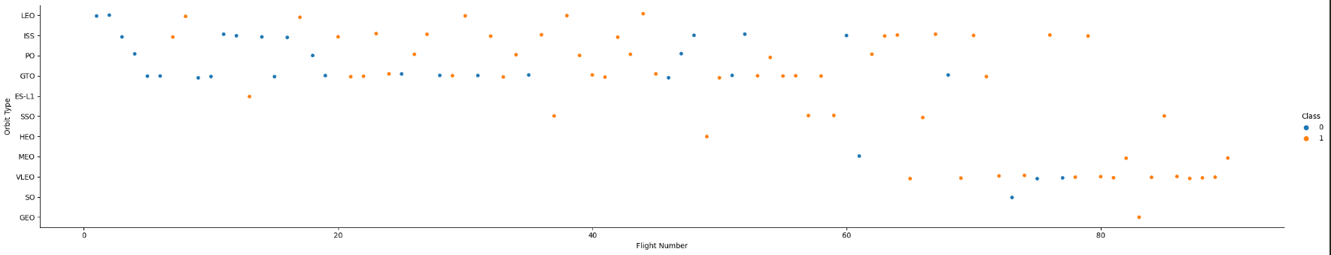
Insights:
SSO had 100% success with five launches, making it a good candidate for Orbit Type Choice.
VLEO had a high number of successes and was tested multiple times with the most recent flight numbers – this is where in previous testing, results were refined when looking at Flight Number vs. Launch Site. This site would make an excellent choice for Orbit type because of the high amount of data in agreement with 100% success in those later launches: even more so than SSO.
GEO, ES-L1 and HEO had 100% success but only one launch, which does not provide enough data.
ISS Had many failures at the beginning of the flights, but after learning from other launches, this Orbit type then began to see high levels of success from flights 60-80.
With it's medium level of success in Flights 20-40 and 60-80 this would also make a good secondary choice to VLEO.
Flight Number vs. Orbit Type
*Reference for success rate of orbit type

Slide 29
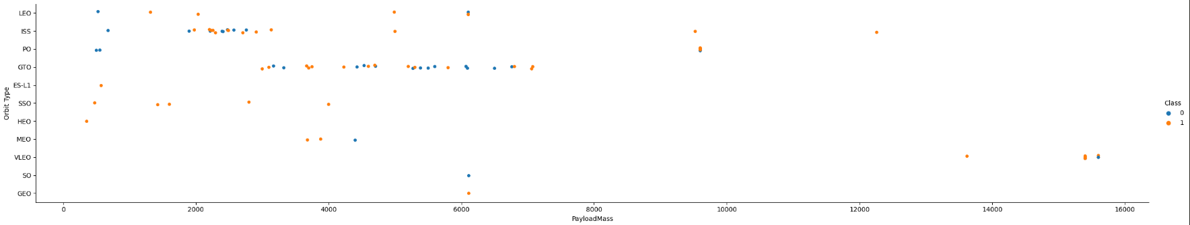
Payload vs. Orbit Type
SSO showed 5 launches 100% successful within the low Payload range of 0kg-4000kg.
ISS had mixed results in lower Payload Mass but increased its success with Payload Mass increased passed 3500kg.
VLEO was only tested at a high payload mass above 13,000 kg, whereas the highest level of successful launches were in lower Payload Mass ranges between 2,000 and 8,000kg.

Slide 30
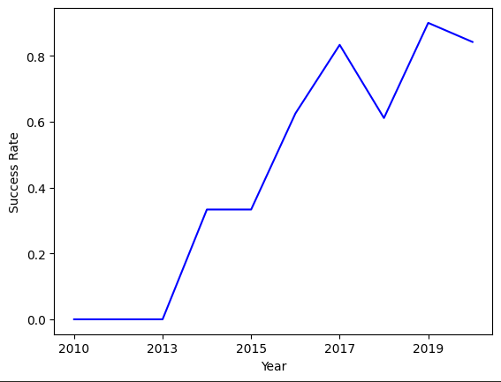
Launch Success Yearly Trend
We see the success rate climbing as the years go on.
2019 Had the highest success rate.
2010 to 2013 had the lowest rates of success.
The 2017-2019 range showed a dip in success but still a high success rate.
We should look at what variables changed to determine what lowered the success rate.

Slide 31
Data Visualization GitHub URL
https://github.com/PrestonMoore3/IBM-Data-Science-Capstone/blob/637f30df5329d691297f511df4d4ffaa46123b7f/Exploratory%20Data%20Analysis%20and%20Data%20Visualization.ipynb
Jupyter Notebook Rendered URL
https://nbviewer.org/github/PrestonMoore3/IBM-Data-Science-Capstone/blob/5c48e5f4c5f513c381153b18240b3162e15e6426/Exploratory%20Data%20Analysis%20and%20Data%20Visualization.ipynb

Slide 32

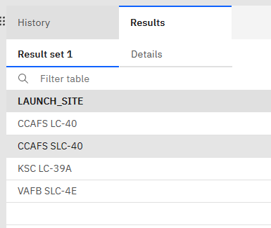
All Launch Site Names
Unique Launch Sites Displayed: 4
Explanation: names of the four unique launch sites.

Slide 33
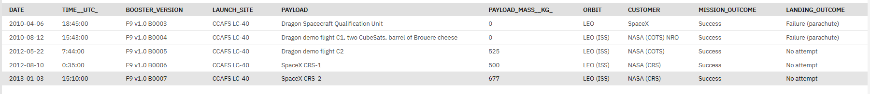
The CCAFS LC-40 Launch Site shows 5 different Payloads, with 5 different Payload Masses (in kg).
The Orbit Type was LEO for all 5 launches.
The Booster Version was F9 v.1.0 for all 5 launches.
All 5 launches were a success but the Landings were failures or not attempted, meaning the Stage 1 was not recovered.
5 Launch Site Names that Begin with 'CCA'

Slide 34
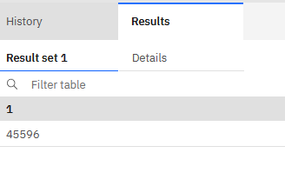
Total Payload Mass
The total payload carried by boosters from NASA was 45,596 kg
This combined all booster versions and payloads for NASA Specifically.

Slide 35
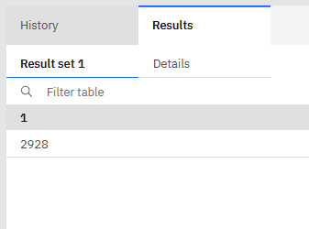
Average Payload Mass by F9 v1.1
The average payload mass carried by booster version F9 v1.1: 2,928 kg
This showed the Booster Version's Average Payload Mass, which was within the range of where the most successful launches occurred overall.

Slide 36
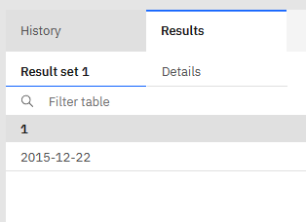
First Successful Ground Landing Date
The Date of the first successful landing outcome on ground pad: 12/22/2015.
Insight: From 2015 and onward, on average the success rate increased, meaning ground pad could have been a factor in that increase.
*Reference: Launch Success Yearly Trend

Slide 37
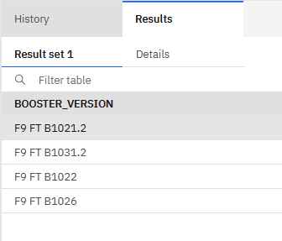
Successful Drone Ship Landing with Payload between 4000kg and 6000 kg
The names of boosters which have successfully landed on drone ship and had payload mass greater than 4000 but less than 6000 is displayed.
The Booster Version was FT B1 in all four cases of Drone Ship Landing with Payload between 4000kg and 6000kg

Slide 38
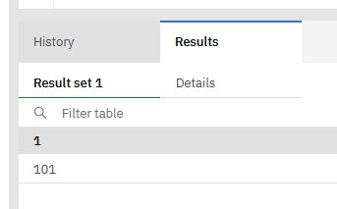
Total Number of Successful and Failure Mission Outcomes
The result shows the total number of successful and failure mission outcomes
The 101 mission outcomes had a success ratio of 0.6666 with a high number of missions.
*Reference: Data Wrangling

Slide 39
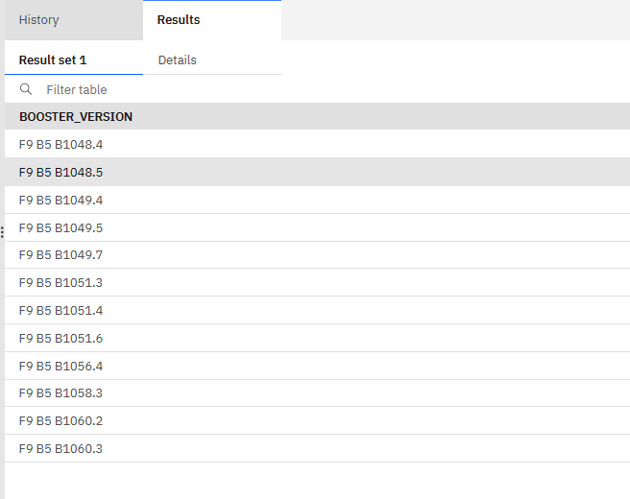
Boosters that Carried Maximum Payload
The listed names of the booster which have carried the maximum payload mass is displayed.
The Booster Version was B5 with slight variations in all cases.
Booster Version B5 had a low rate of success because the Maximum Payload in Kg also had a low rate of success.
*Reference: Payload Mass (kg) Dashboard Visualization, and Scatter Plots of Payload Mass (kg) success rates.

Slide 40
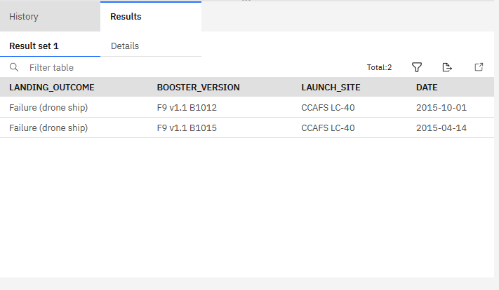
2015 Launch Records
Displayed are the Failed Landings in drone ship, the booster versions, and launch site names for the year 2015.
The booster version and launch site were consistent: Booster Version v.1.1 and CCAFS LC-40.
Drone ship failed landings in 2015 had a correlation with Booster Version v 1.1 and the CCAFS LC-40 Launch Site.
For future success, the launch site and/or Booster Version would need to be changed to see if there could be success with drone ship landings.

Slide 41
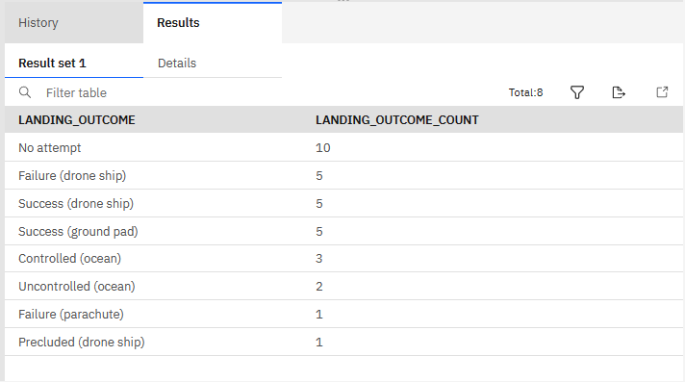
Ranked Landing Outcomes Between 2010-06-04 and 2017-03-20
Displayed are the ranked counts of landing outcomes between the date 2010-06-04 and 2017-03-20, in descending order.
The highest landing outcome counts of failure and success were both drone ship, with a 50/50 split between success and failure.
The highest success rate with conclusive evidence is ground pad, where the count was 5 successes with 0 failures displayed.

Slide 42
EDA with SQL GitHub URL
https://github.com/PrestonMoore3/IBM-Data-Science-Capstone/blob/85f3347b82e2b01010b1fb320fe703619b771523/jupyter-labs-eda-sql-coursera_sqllite%20-%202nd%20version.ipynb
Jupyter Notebook Rendered URL
Please download locally to view.

Slide 43

Section 3

Slide 44
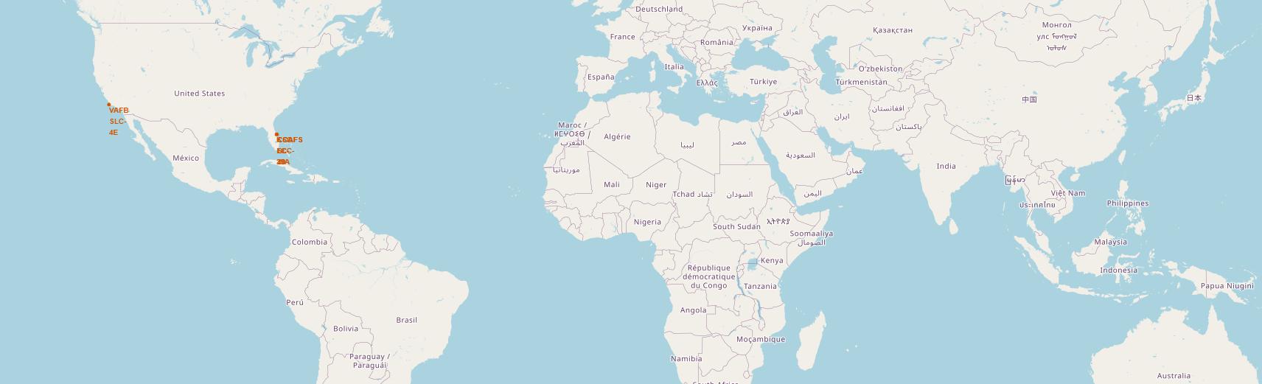
Falcon 9 Unique Launch Sites
All of the Launch Sites were located in the United States of America.
All Launches were near a coastline.
All launches were in the Southern United States.
All launch sites were somewhat near the equator, north of the equator about the same amount.

Slide 45
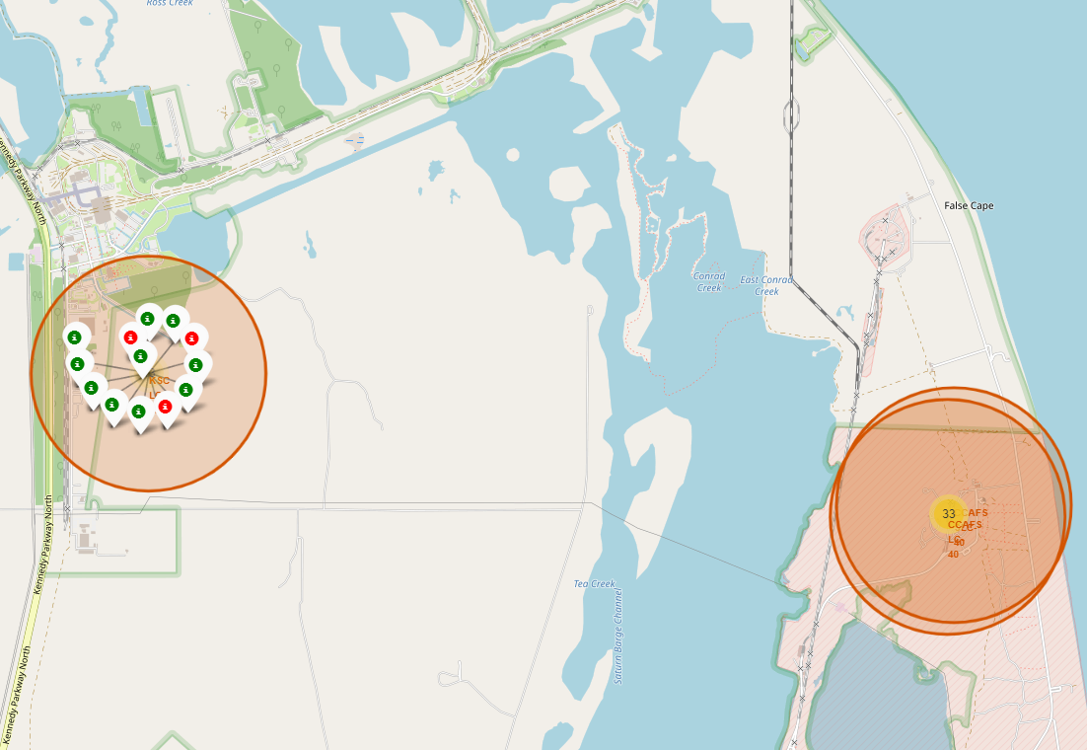
Launch Outcomes by Launch Site
Site: KSC LCA-39A
1
We see a high percentage of success ratio to failure at this site.
2

Slide 46
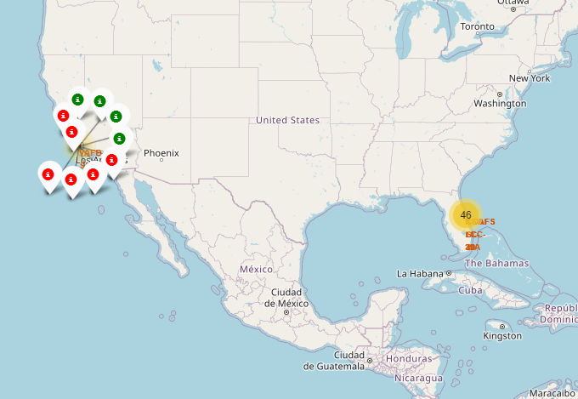
Launch Outcomes by Launch Site
Launch Site: VAFB SLC-4E
1
A Low success ratio
2

Slide 47
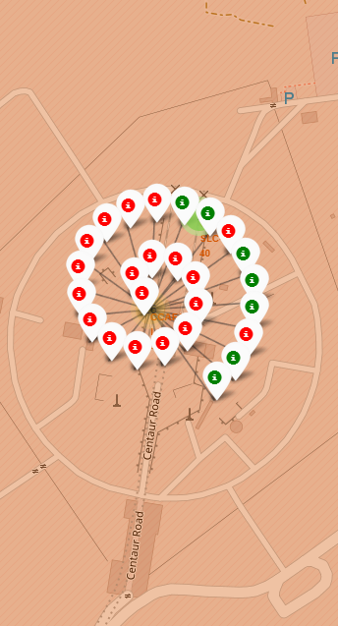
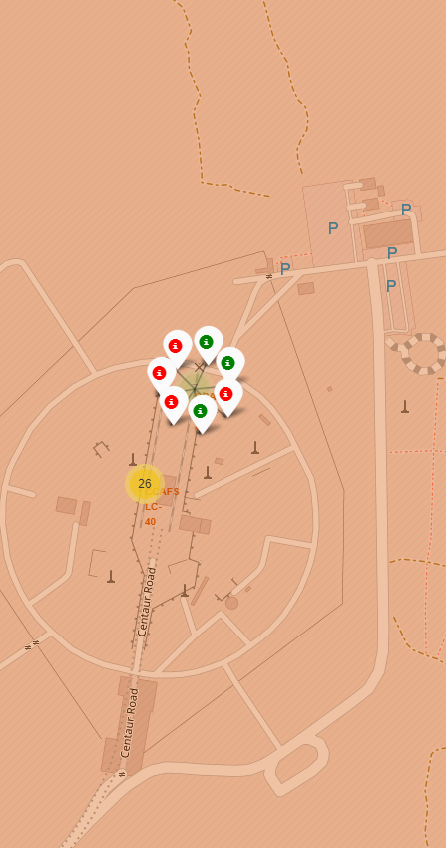
Launch Outcomes by Launch Site
CCAFS LC-40
2
CCAFS SLC-40
1
Low Success Ratio
Moderately Low Success Ratio
Lower number of launches

Slide 48
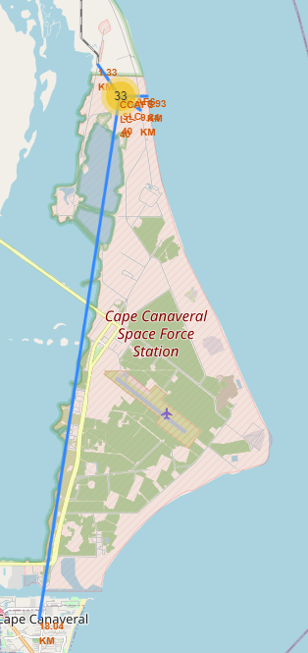
CCAFS LC-40 Launch Site in Proximity to a Close Railway, Highway, Coastline, and City
Findings:
Proximity to Coastline, Railway, and Highway were all very close.
Proximity to a City was the farthest distance.
There are multiple coastlines in each direction very close to the Launch Site.

Slide 49
Folium Maps GitHub URL
https://github.com/PrestonMoore3/IBM-Data-Science-Capstone/blob/637f30df5329d691297f511df4d4ffaa46123b7f/Launch%20Sites%20Location%20Analysis%20with%20Folium.ipynb
Jupyter Notebook Rendered URL
https://nbviewer.org/github/PrestonMoore3/IBM-Data-Science-Capstone/blob/99cab735536b0dee6616ebc8344d70e18dcf8368/Launch%20Sites%20Location%20Analysis%20with%20Folium.ipynb

Slide 50

Section 4

Slide 51
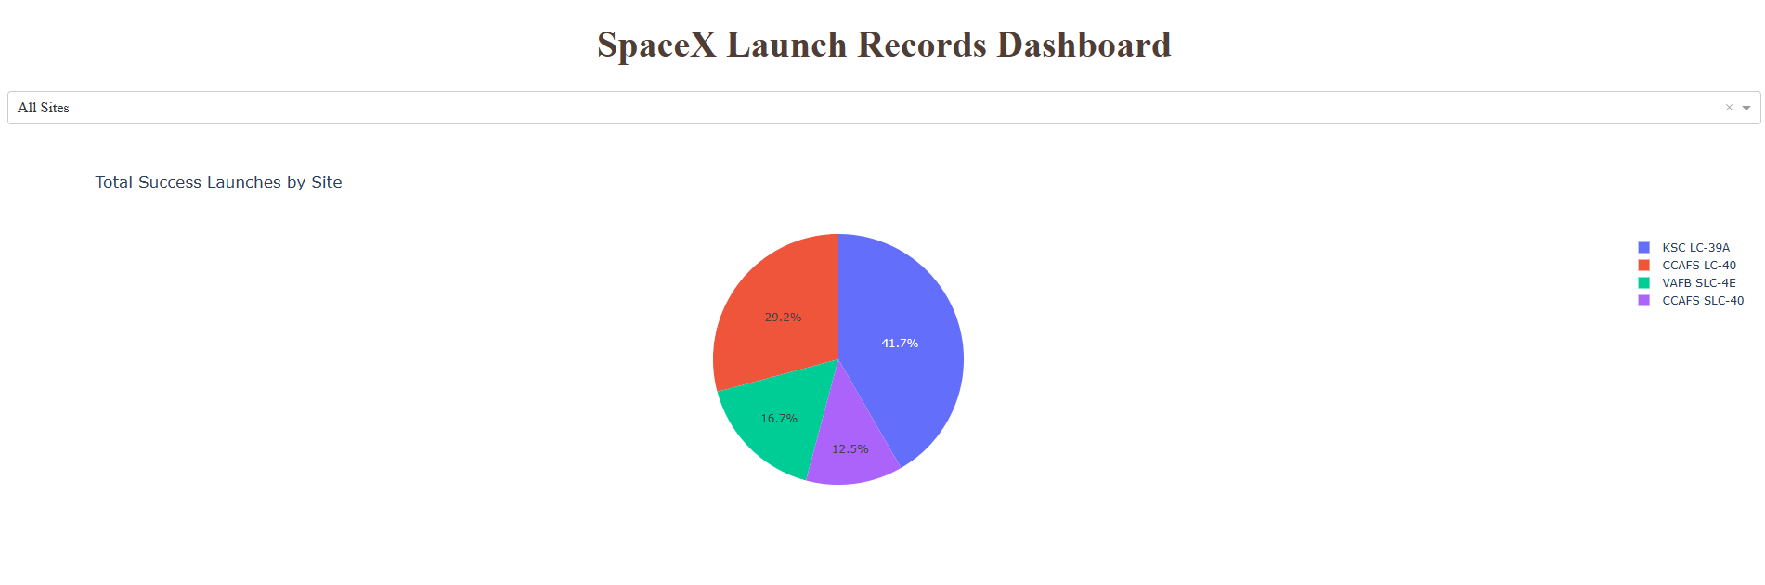
Looking at all sites, we see the highest success rate based on Launch Site was KSC- LC-39A with 41.7% of the successful landings in comparison to lower percentages of overall success rate between each of the other 3 Launch Sites.
This highlights KSC LC-39A as the launch site promoting the most amount of success and will be targeted for the suggested launch site due to the success rate.
This is a preliminary finding that requires further discovery since it only shows the number of successes, not the ratio of successes within the launch site itself.
Total Successful Launches by Site

Slide 52
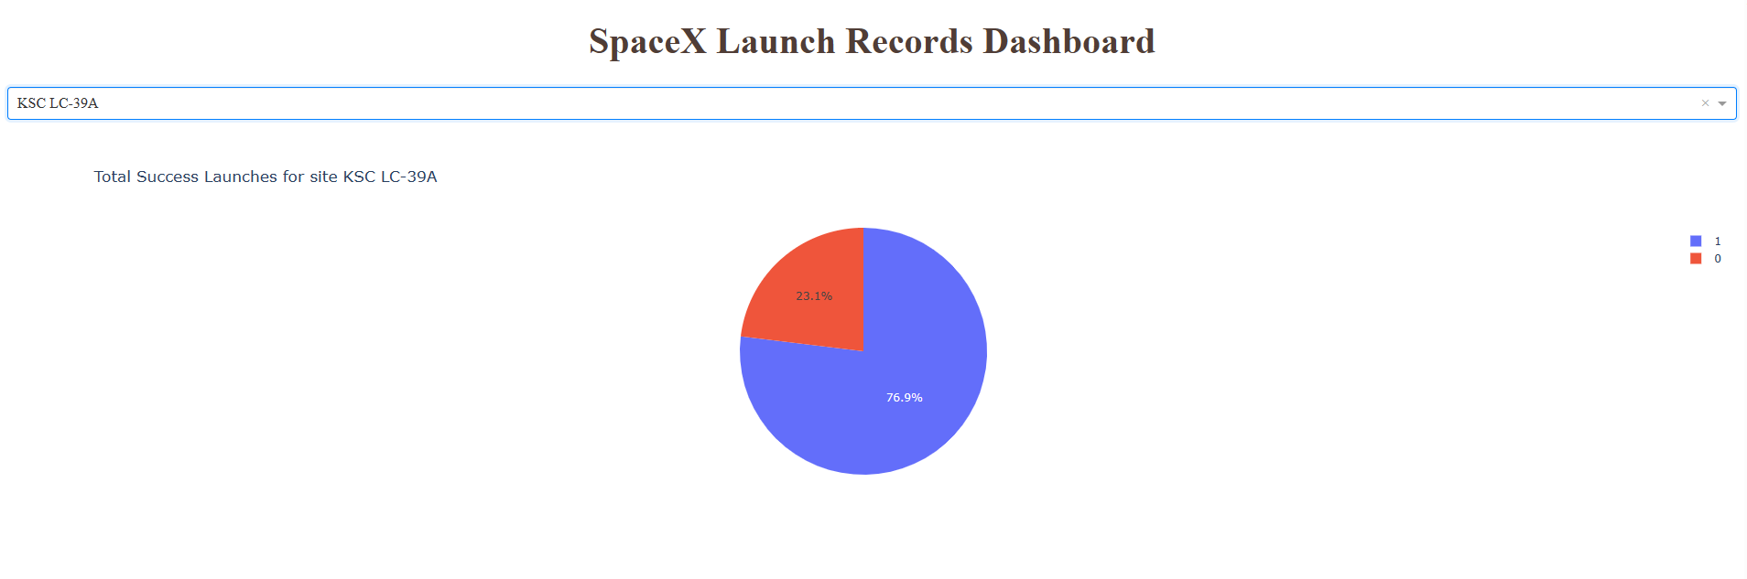
Lauch Site with Highest Launch Success Ratio
Since KSC LC-39A has the highest number of successes, we want to focus on its percentage of success versus failure ratio, rather than sole number of successes.
When looking at the total success launch ratio, we see a 76.9% success rate for all launches at KSC LC-39A.
We looked at all percentages of launch site successes, with KSC LC-39A proving the highest rate of successful landings versus unsuccessful landings.

Slide 53
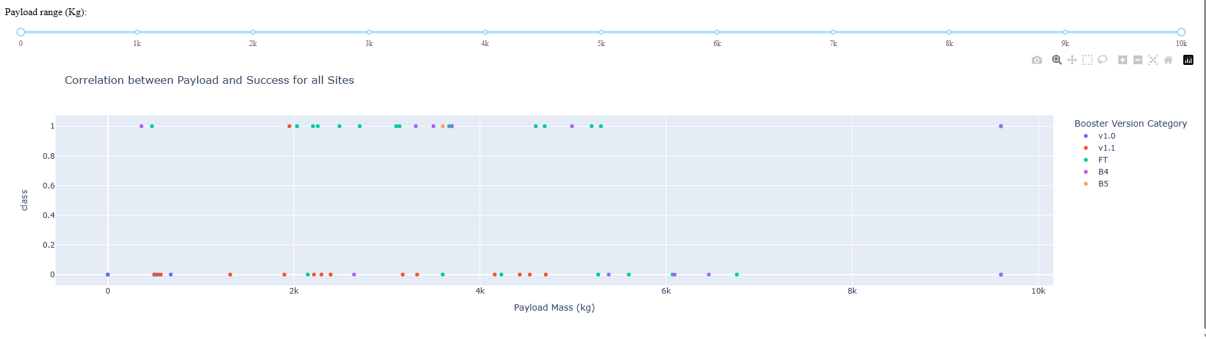
Payload vs. Launch Outcomes for All Sites
High Success Rates Overall
Booster Version Category: FT
Booster Version Category Runner-Up: B4
Payload Mass (kg) within the 1k-6k (kg) range
LOW Success Rate:
v. 1.1 in all Payload Mass ranges.
High Payload Mass (kg) with Booster Version B4 and FT above 6000kg

Slide 54
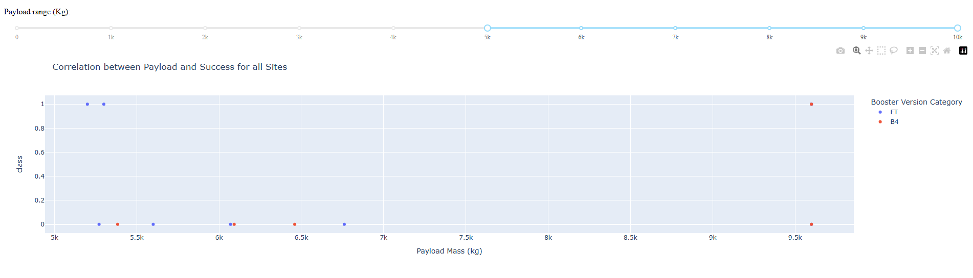
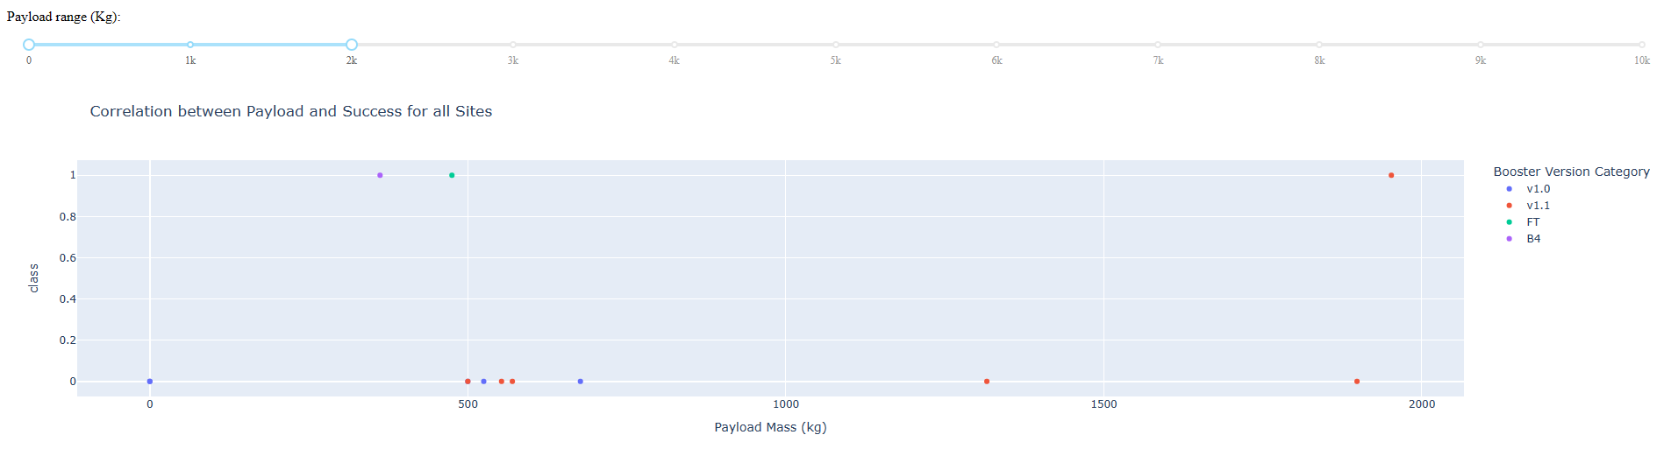
Payload vs. Launch Outcomes for All Sites
The slider here is used to focus in solely on high Payload Mass (5000kg to 10,000kg) and low Payload Mass (0 kg to 2000kg). We see low levels of success for launch outcomes in both of these ranges.

Slide 55
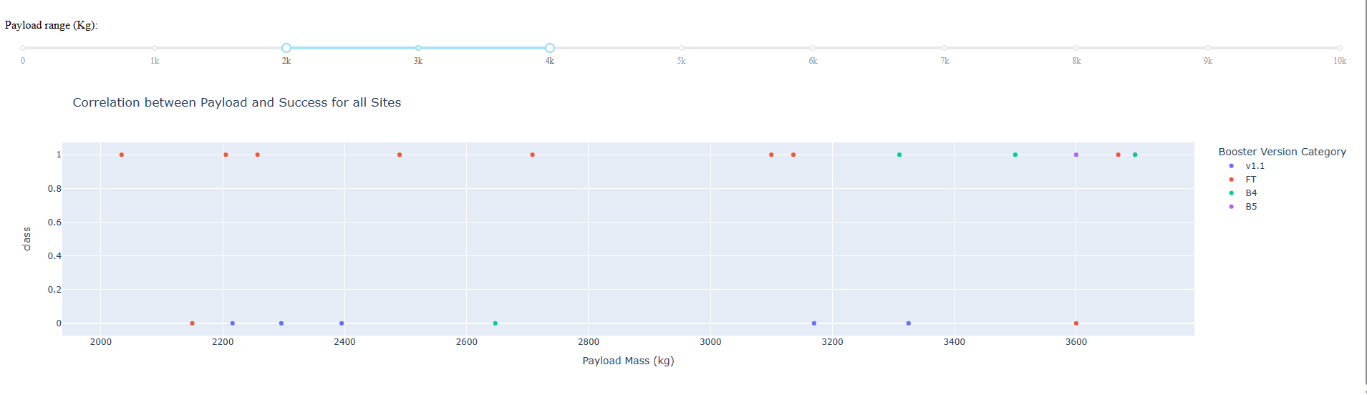
Payload vs. Launch Outcomes for All Sites
Insight:
This Payload Mass range of 2000kg to 4000kg showed the ideal range of successful launches with the highest successful Booster Version Category of FT.

Slide 56
Plotly Dashboard GitHub URL
https://github.com/PrestonMoore3/IBM-Data-Science-Capstone/blob/637f30df5329d691297f511df4d4ffaa46123b7f/Spacex_Data%20Plotly%20Dashboard.py

Slide 57

Section 5

Slide 58
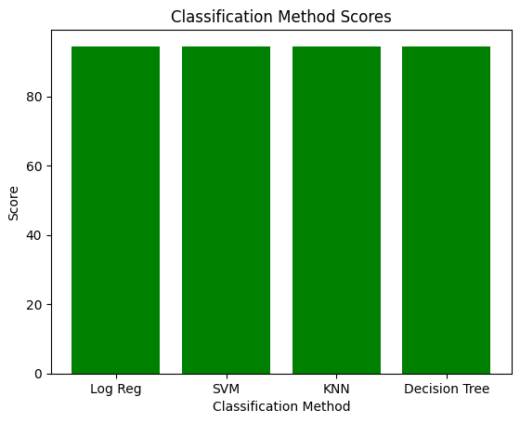
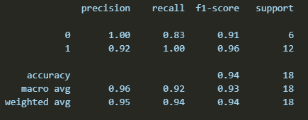
Classification Accuracy
The classification method scores highlight that each machine learning algorithm reflected a predicted accuracy of 94.4% of the success ratio being 83.3%.
Each algorithm produced almost the exact same F1 Score, showing equally that looking at the predicted landing, we can predict with high accuracy that the First Stage will likely land.

Slide 59
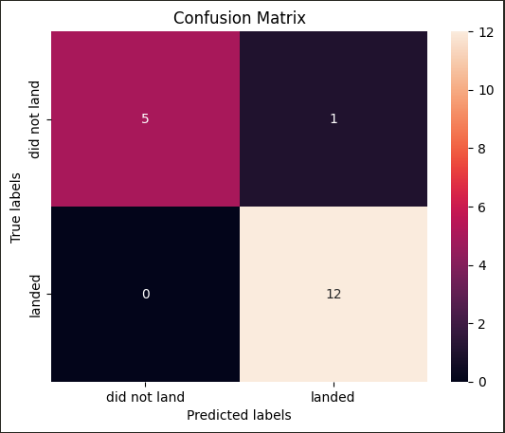
Confusion Matrix
This Confusion matrix is taken from the K-Nearest Neighbors Method, which also is equal to the other three methods.
The model's prediction was highly accurate, especially when predicting 12/13 landings correctly, and 5/5 non-landings correctly.
We see that the model will accurately predict a classification of landing or not landing based on the data supplied.

Slide 60
Machine Learning GitHub URL
https://github.com/PrestonMoore3/IBM-Data-Science-Capstone/blob/bf964f516931d524f4bafefc273526fd1a1b2f2f/SpaceX%20Machine%20Learning%20Prediction%20Part%205.ipynb
Jupyter Notebook Rendered URL
Please download locally to view notebook.

Slide 61
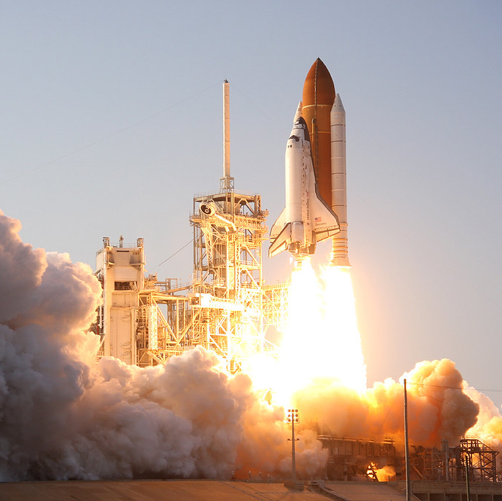
Conclusions
The most successful launch site was KSC LC-39A.
The ideal launch site has proximity to multiple coastlines on the Atlantic Ocean with a latitude/long of approximately 28.57 and –80.6 respectively, with a larger distance between the launch site and a city.
The Payload Mass in kg should be 2,000kg to 6,000kg to maximize the success rate.
The Orbit Type SSO had 100% Successful Launches, all within the Payload Mass (kg) maximal success rate range, making it the suggested Orbit Type to implement.
The Booster Version within the Payload Mass range was FT with the highest level of successful Launch Outcomes making the suggested Booster Version FT.
The highest success rate with conclusive evidence for Landing Outcomes is ground pad.
There is a high level of certainty using the Predictive Modeling that the ideal conditions will create a successful landing.

Slide 62
Appendix

Slide 63
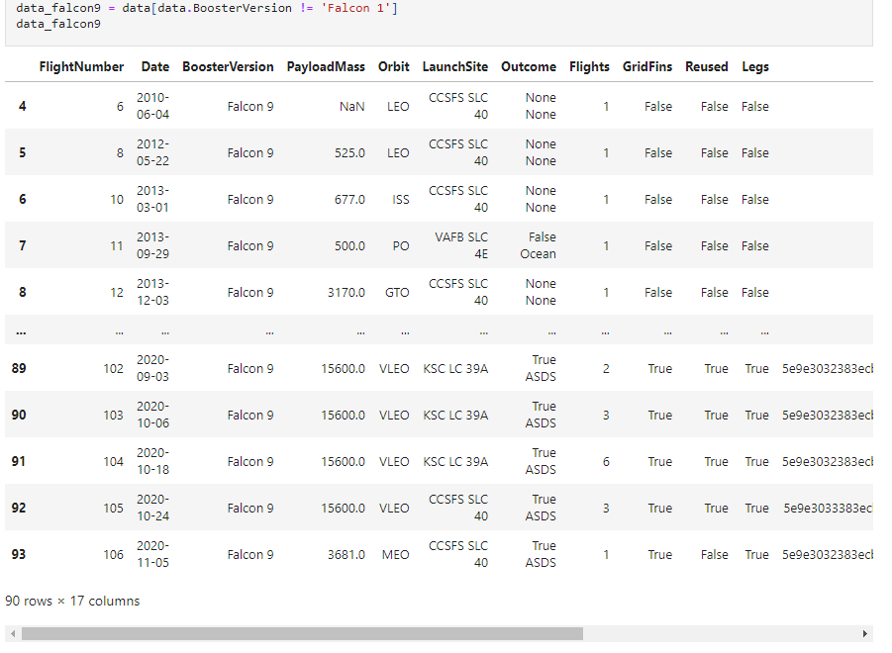
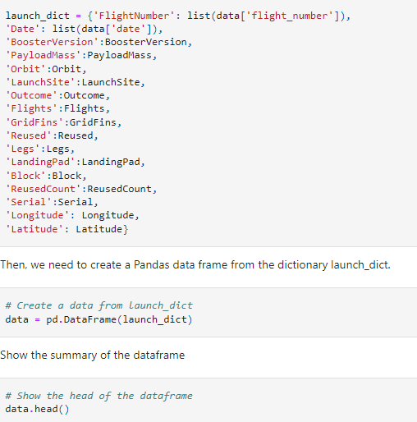
Code Snippet
The code here put together a dictionary using pre-defined user functions to gather all of the information from the SpaceX Dataset, cleaned, to then make a dataframe of all of the launches, then filtered for only Falcon 9 Launches.

Slide 64
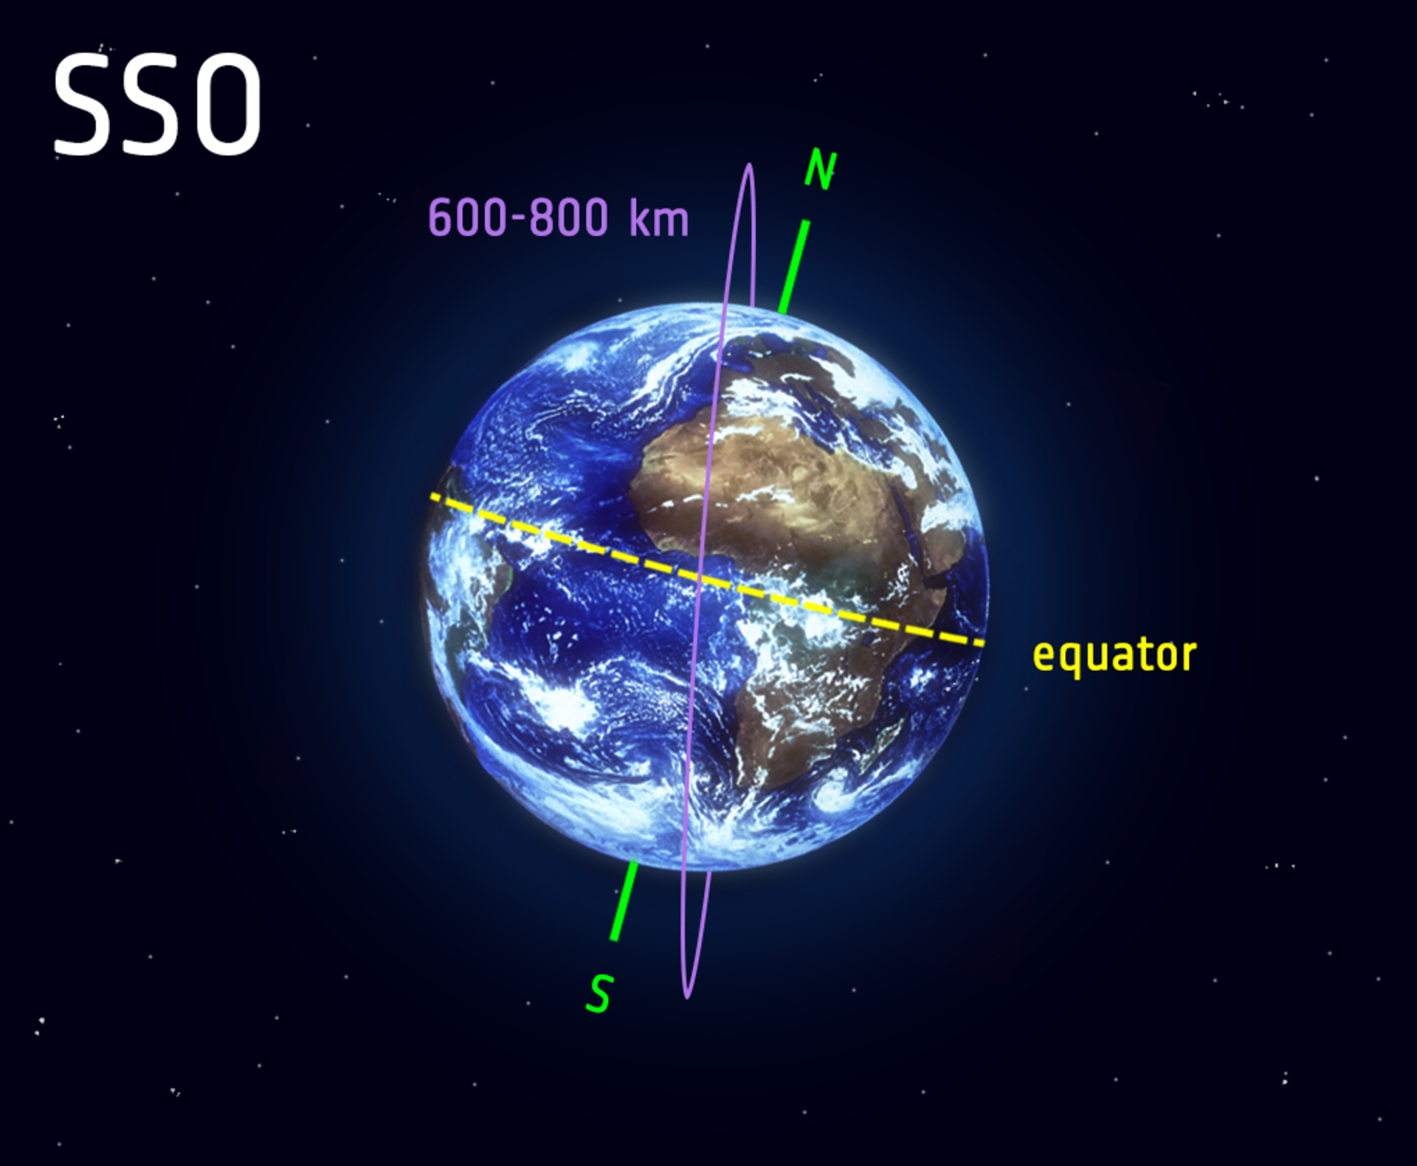

SSO (or SO): It is a Sun-synchronous orbit--also called a helio-synchronous orbit--is a nearly polar orbit around a planet, in which the satellite passes over any given point of the planet's surface at the same local mean solar time [4] .
Suggested Orbit Type

Slide 65
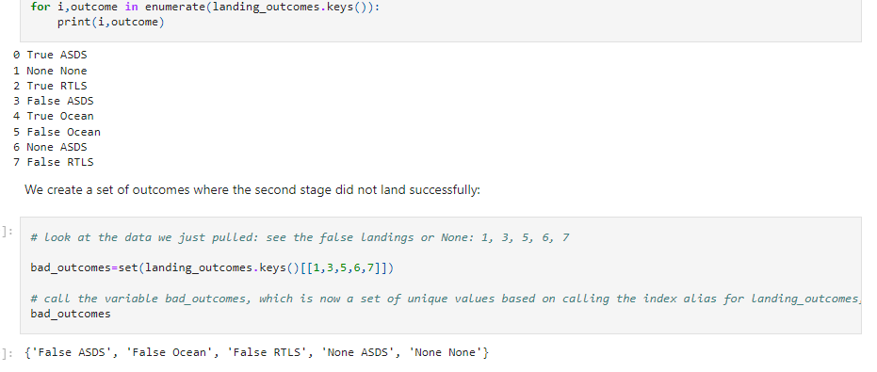
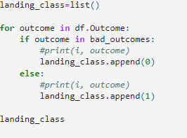
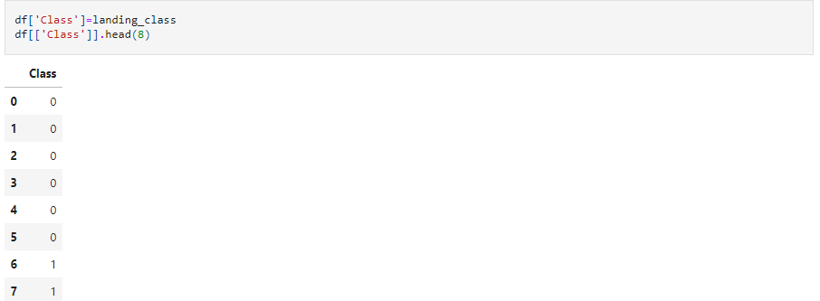
Creating the Landing Classifications for Successful or Failed Landings
Added the Class Column to the Dataframe

Slide 66
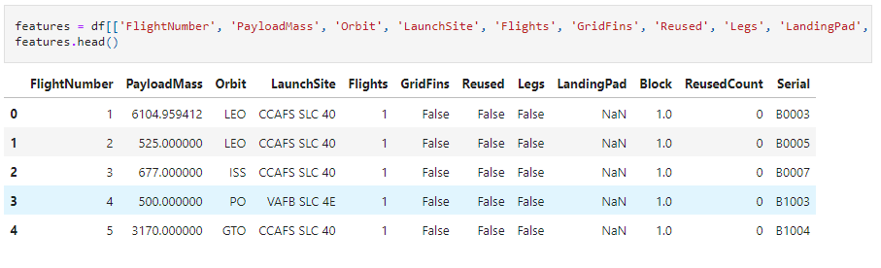
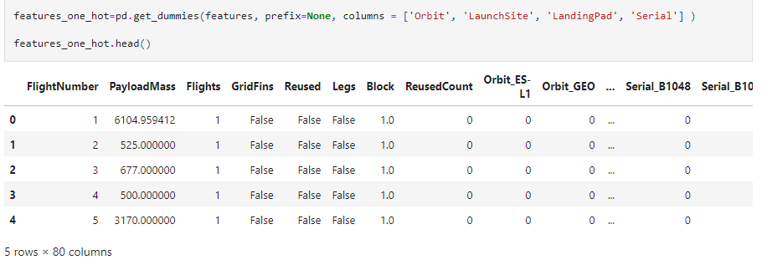
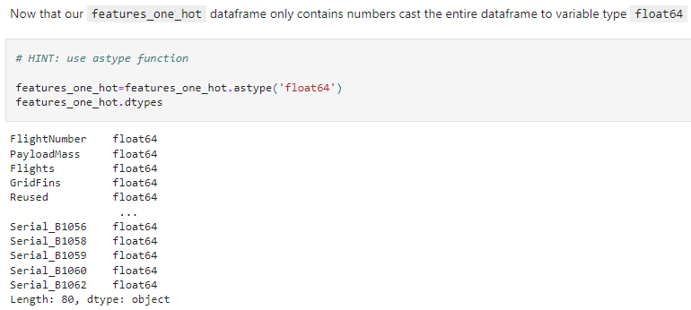
Feature Engineering

Slide 67


